Slide 1

Analysis by Simona Valente

Slide 2

Tools used
What you will find in the repository
GOAL
Analyze the "European Soccer Database” to extrapolate useful data and information.
Data Analysis: SQL on Google Bigquery
Supporting graphs: Python on Google Colaboratory
Presentation: Google Slides
Dataset used: match.csv, leagues.csv, team.csv, player.csv, match_per_month.csv;
Relational schema;
A document with the ordered list of queries used;
This presentation;
A python notebook.

Slide 3
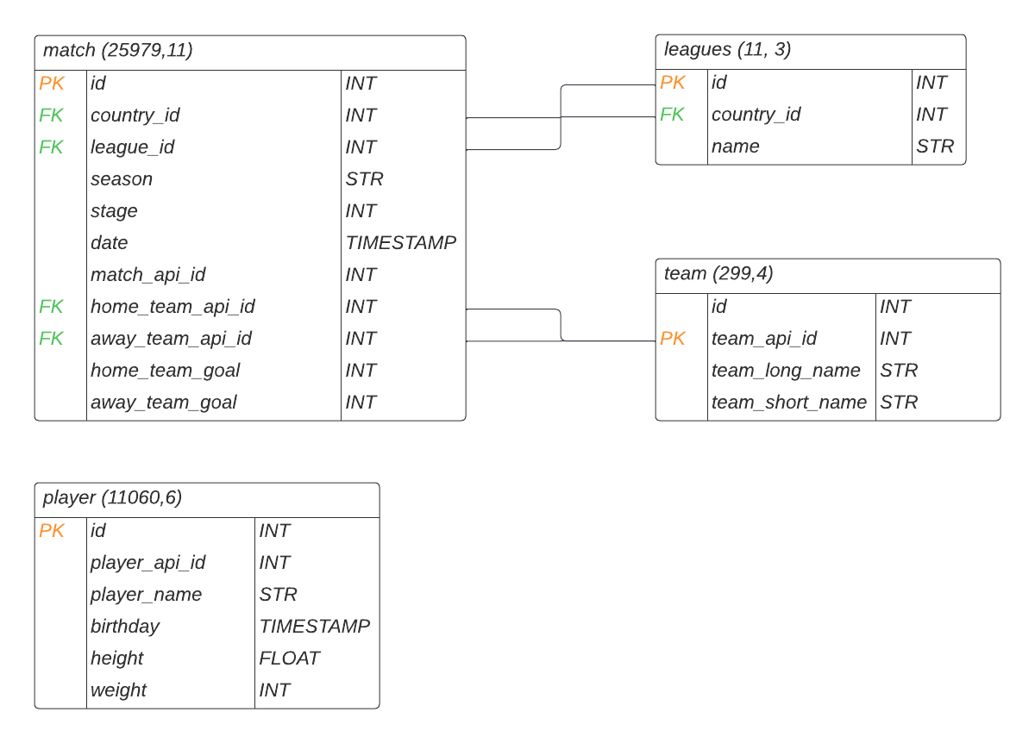
The Database
The analysis was carried out on the European Soccer database.
It is composed of 4 datasets:
match;
leagues;
team;
player.
The relational scheme →

Slide 4
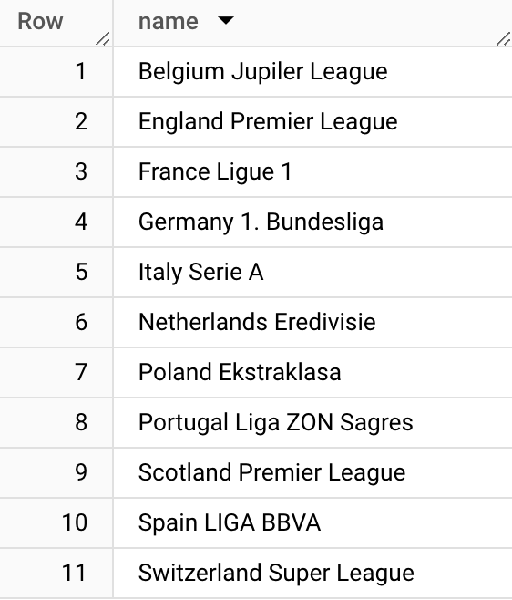
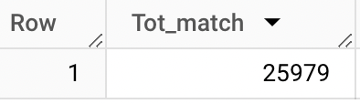
Preliminary phase: let's familiarize ourselves with the database. How many matches and leagues in total are we analyzing?
TOTAL LEAGUES
TOTAL MATCHES

Slide 5
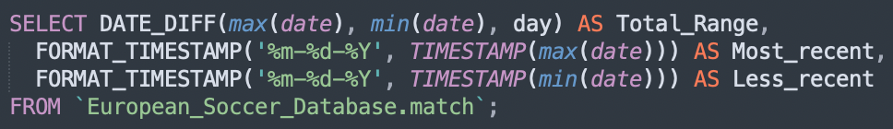
What is the reference time range?
I go to print:
- the difference between the most recent date and the most distant one;
- the two dates at the extremes.
It results that our time range is 2868 days; while the most recent date is May 25, 2016 and the oldest is July 18, 2008.

Slide 6
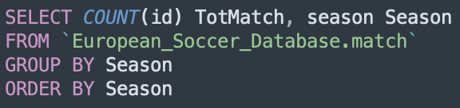
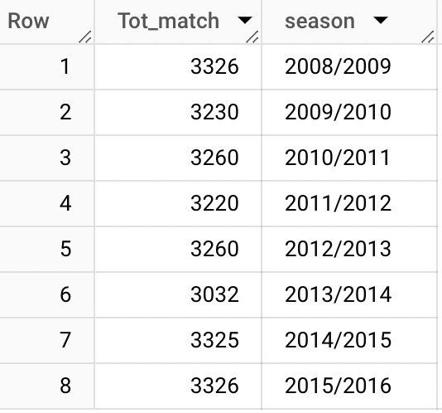
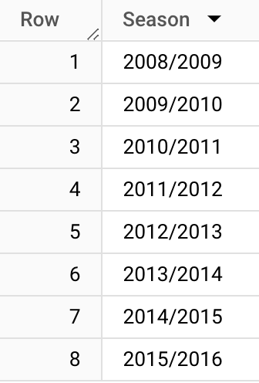

How many seasons are there in total and how many matches for each season?
SEASON: we have all the data for the seasons ranging from 2008 to 2016.
MATCHES FOR SEASON: there are no significant differences, except for the 2013/2014.

Slide 7
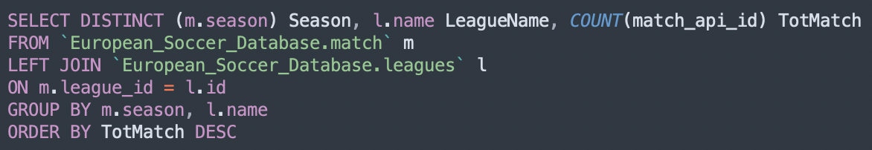
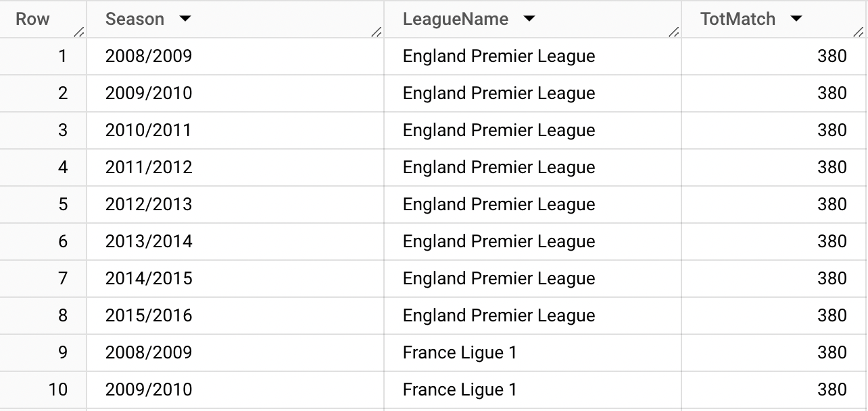
How many matches are there divided by season and league? Do we notice anything out of the ordinary?
Belgium Jupiler League only has 12 matches in 2013/2014

Slide 8
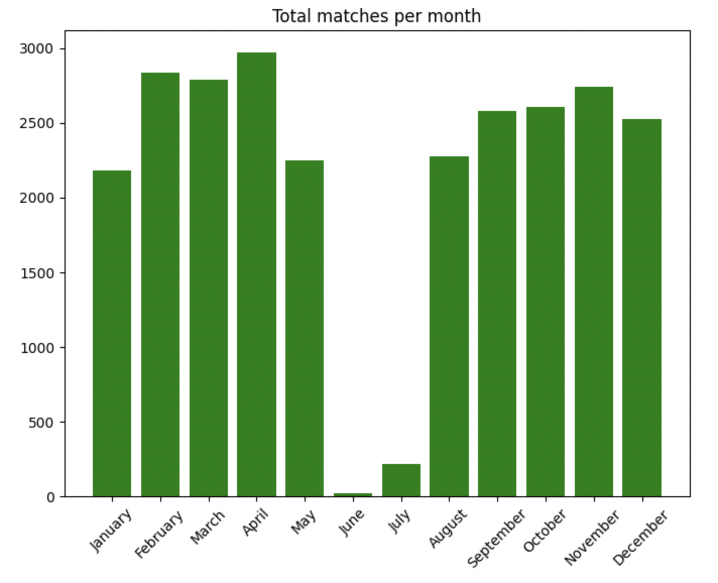
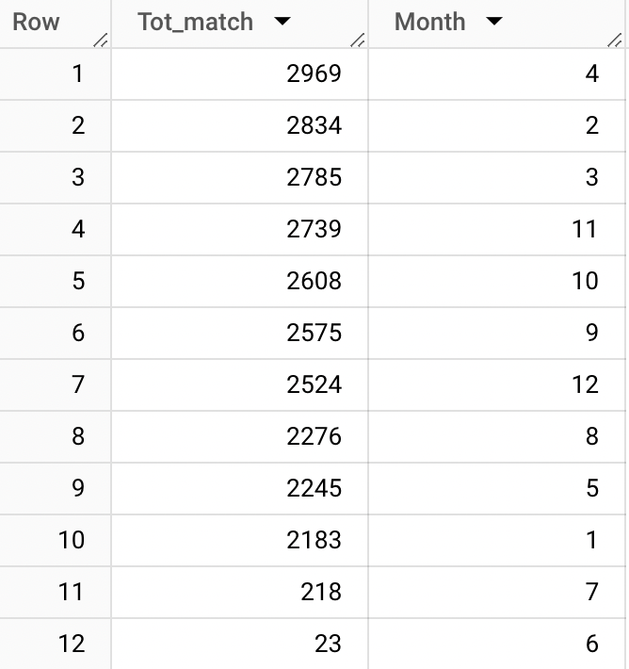
How many matches were there for each month of the year?
2969

Slide 9
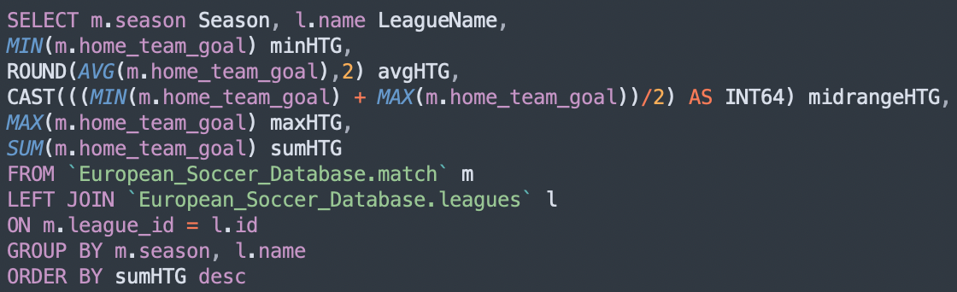
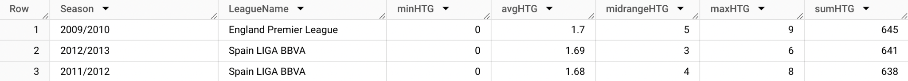
Season and League: statistics on goals scored at home
We produce a table that shows for each Season and League Name the following statistics about the home goals scored: min, average, mid-range, max and sum.
The season with the most home goals was 2009/2010 in England Premiere League

Slide 10
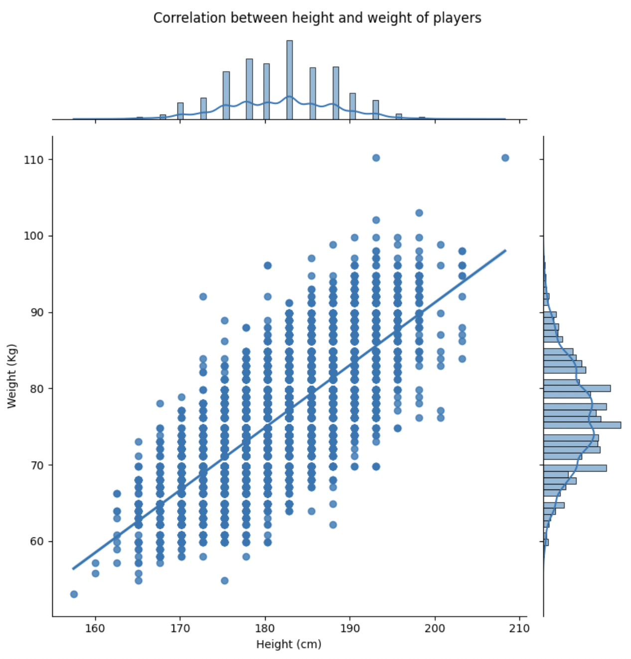
Let's now analyze the players.
The graph shows the relationship between the height of our athletes and their weight. As we can see, the two variables are directly proportional, with a correlation of 0.77%

Slide 11
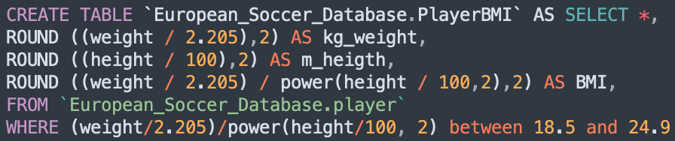

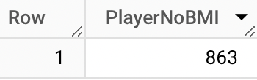
7,8% discarded
Let's create a new 'PlayerBMI' table in which we insert:
the weight in kg (kg_weight);
the height in meters (m_height);
the player's body mass index (BMI).
We filter the table to only show players with an optimal BMI (18.5 to 24.9).
By subtracting the filtered athletes from the total ones, we find that 863 players do not have an ideal BMI.

Slide 12
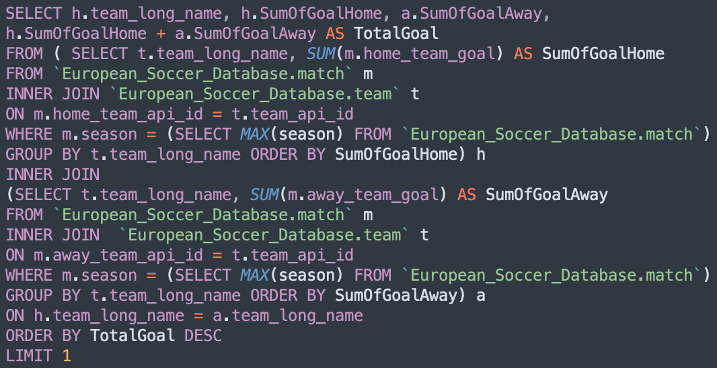
Which Team has scored the highest total number of goals during the most recent available season?

Slide 13
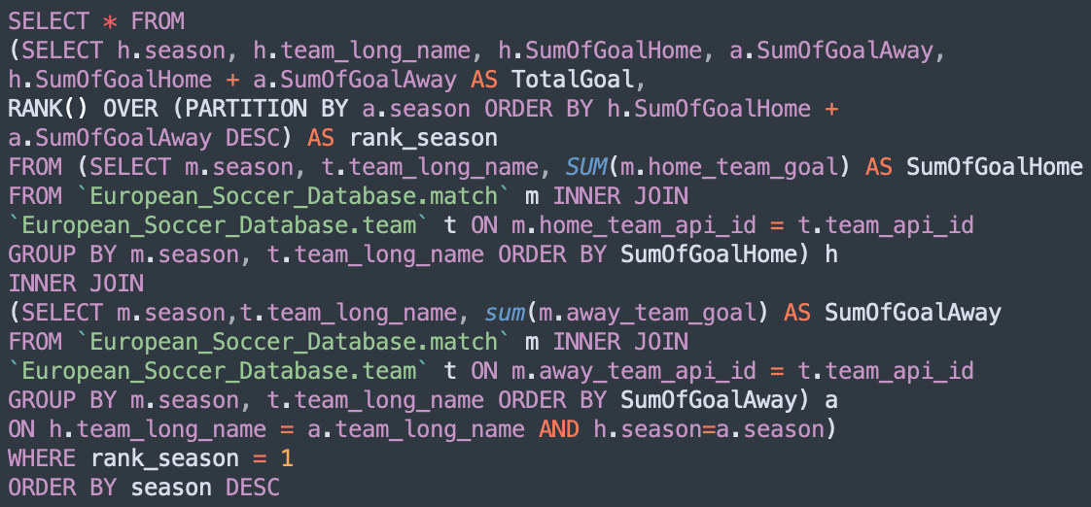
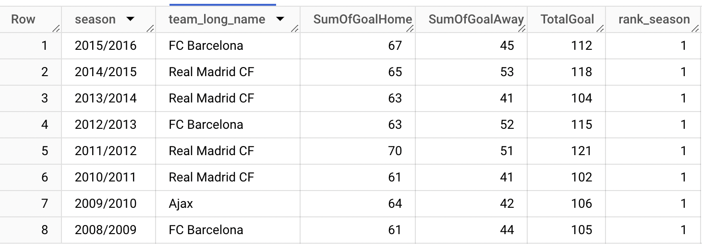
For each season, which team ranks first in terms of total goals scored?
Real Madrid CF is the team that has ranked first for the most seasons.

Slide 14
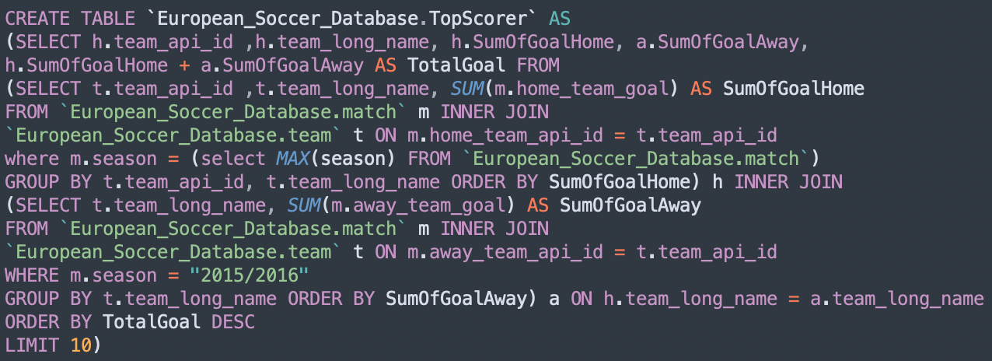
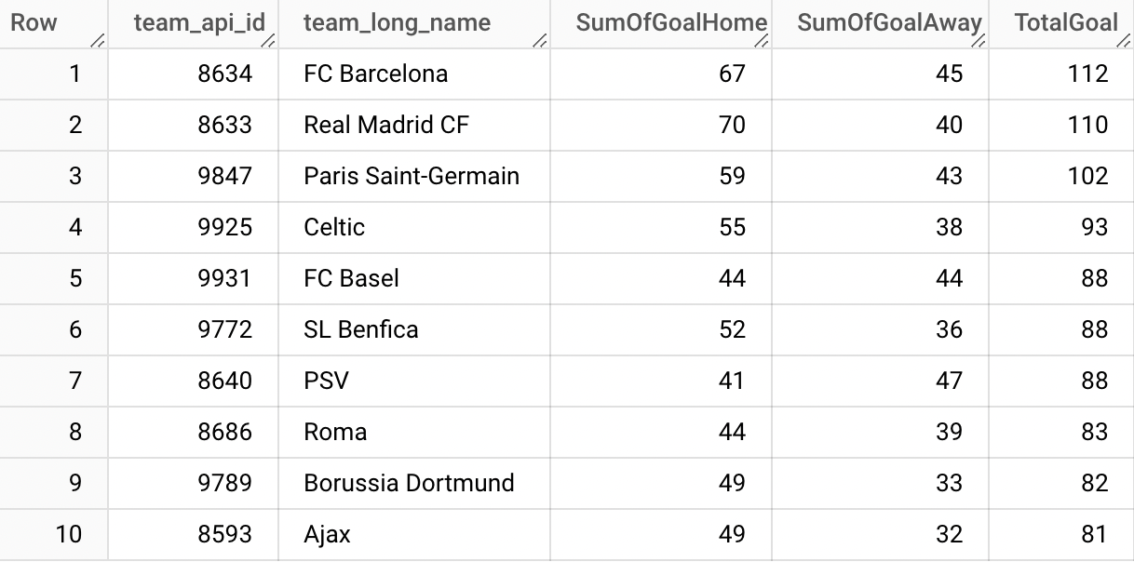
Create a new table 'TopScorer' containing the top 10 teams in terms of total goals scored

Slide 15
Thanks for the attention!
You can find all the queries used within the repository

